Slide 1
WMR mine detector D3aj buggy
Table of contents

Slide 2
Table of contents
01
02
03
04
05
06
Introduction
Sensor
Arm
Circuit &controller
Design
Code

Slide 3
01
Introduction

Slide 4
Introduction
Mobile robots are being used to access areas such as nuclear power plants, where factors, like high radiation, make the area too dangerous for humans to inspect and monitor themselves.

Slide 5
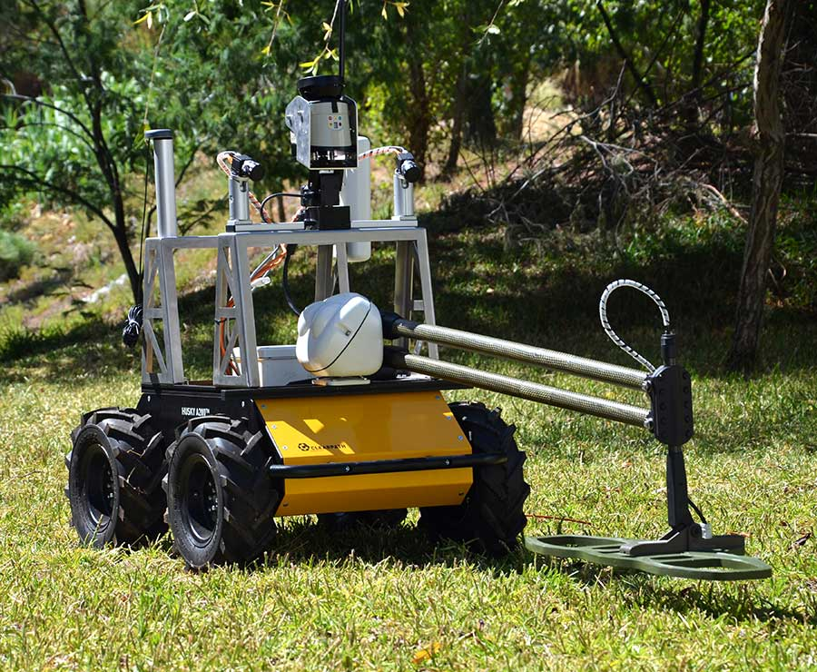
A PROJECT TO END OVER 20,000 DEATHS PER YEAR.
Minesweeping is an extremely dangerous process and is mostly completed by human operators. over 20,000 people are killed by mine-related accidents per year. At the current rate, it would take close to 1,100 years to remove all active land mines in the world.

Slide 6
Sensor
02
In 2012, Clearpath Robotics decided to give away a customized Husky UGV to a worthy cause, and what could be more worthy than keeping us humans from getting blown up. The University of Coimbra in Portugal has taken its free Husky and turned it into a clever little autonomous mobile mine detector.
Clearpath Husky UGV

Slide 7
02
Sensor
How Do Metal Detectors Work?

Slide 8
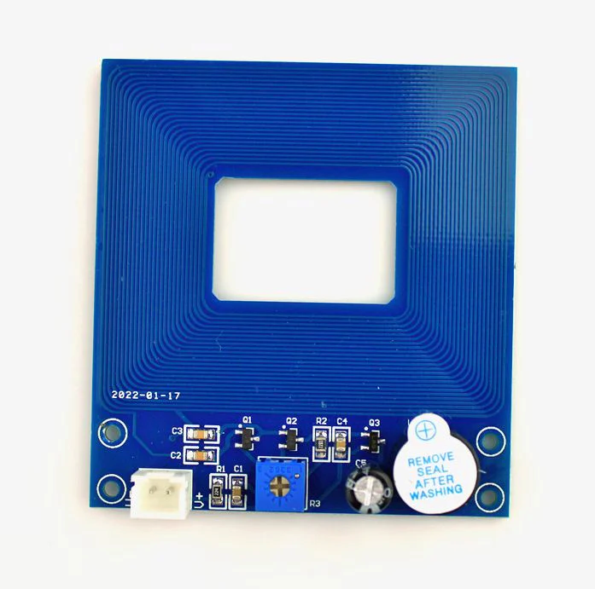
Sensor
How Do Metal Detectors Work?
Metal detectors work by transmitting an electromagnetic field from the search coil into the ground. Any metal objects (targets) within the electromagnetic field will become energized and retransmit an electromagnetic field of their own. The detector’s search coil receives the retransmitted field and alerts the user by producing a target response.

Slide 9
03
Arm
since these sensors are banned in our country, we used this small sensor as a prototype until we can get a permission to use more powerful sensor.
A88 Metal Detector Non-Contact Metal Induction Detection Module

Slide 10
03
Arm

Slide 11
Arm
Stationary robot ( arm, manipulator ,etc.) are widely used in a lot of fields such as:
Manufacturing and Assembly
1) Automobile Assembly
2) Electronics Assembly

Slide 12
Stationary robot ( arm, manipulator ,etc.) are widely used in a lot of fields such as:
Manufacturing and Assembly
1) Automobile Assembly
2) Electronics Assembly
Material Handling
1) Loading and Unloading
2) Packaging
and much more application's

Slide 13
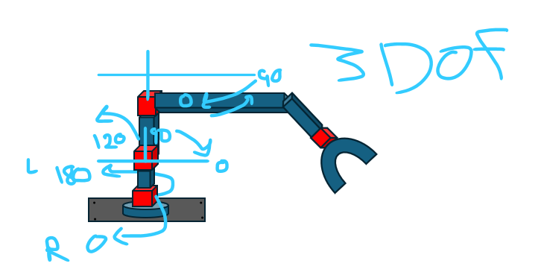
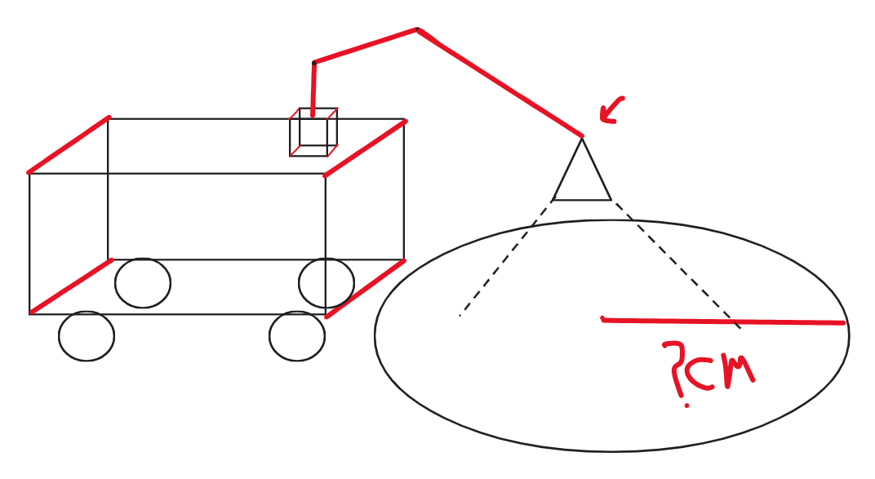
Stationary robot ( arm, manipulator ,etc.) are widely used in a lot of fields such as:
Manufacturing and Assembly
1) Automobile Assembly
2) Electronics Assembly
Material Handling
1) Loading and Unloading
2) Packaging
and much more application's

Slide 14
Circuit
The importance of the arm in mine detector robots lies in that it allows the robot to inspect areas and locate mines from a safe distance to also protect the robot from explosion.
04

Slide 15

04
Circuit

Slide 16
Circuit
controller
to design our circuit, we used

Slide 17
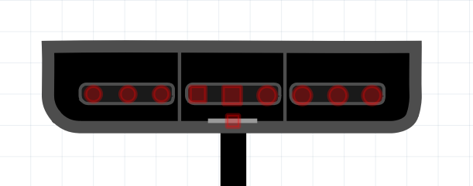
controller
Data
VCC
Acknowledge
Vibration
Receiver
The wireless controller works with 2.4GHz frequency and it has a range of 10 meters. It also has an optical indicator for sending and receiving data. This controller needs only 3 AAA batteries for power (in some cases it needs just 2 AAA batteries).
clock
GND
attention
No connection
command

Slide 18
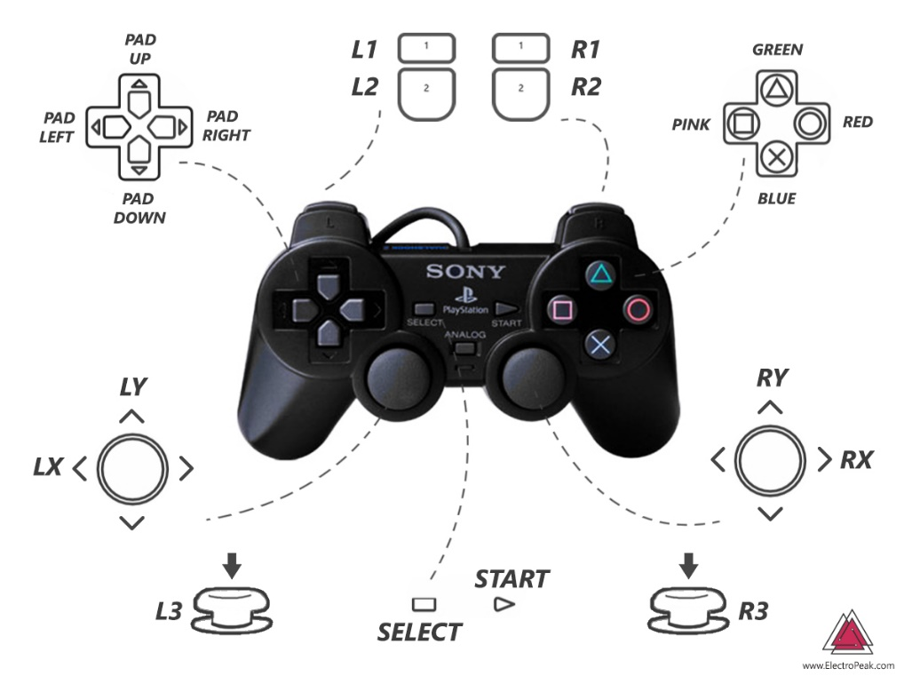
transmitter
Receiver
Acknowledge
clock
Vibration
Data
VCC
GND
attention
command
No connection

Slide 19
Design
transmitter
05

Slide 20
05
Design

Slide 21
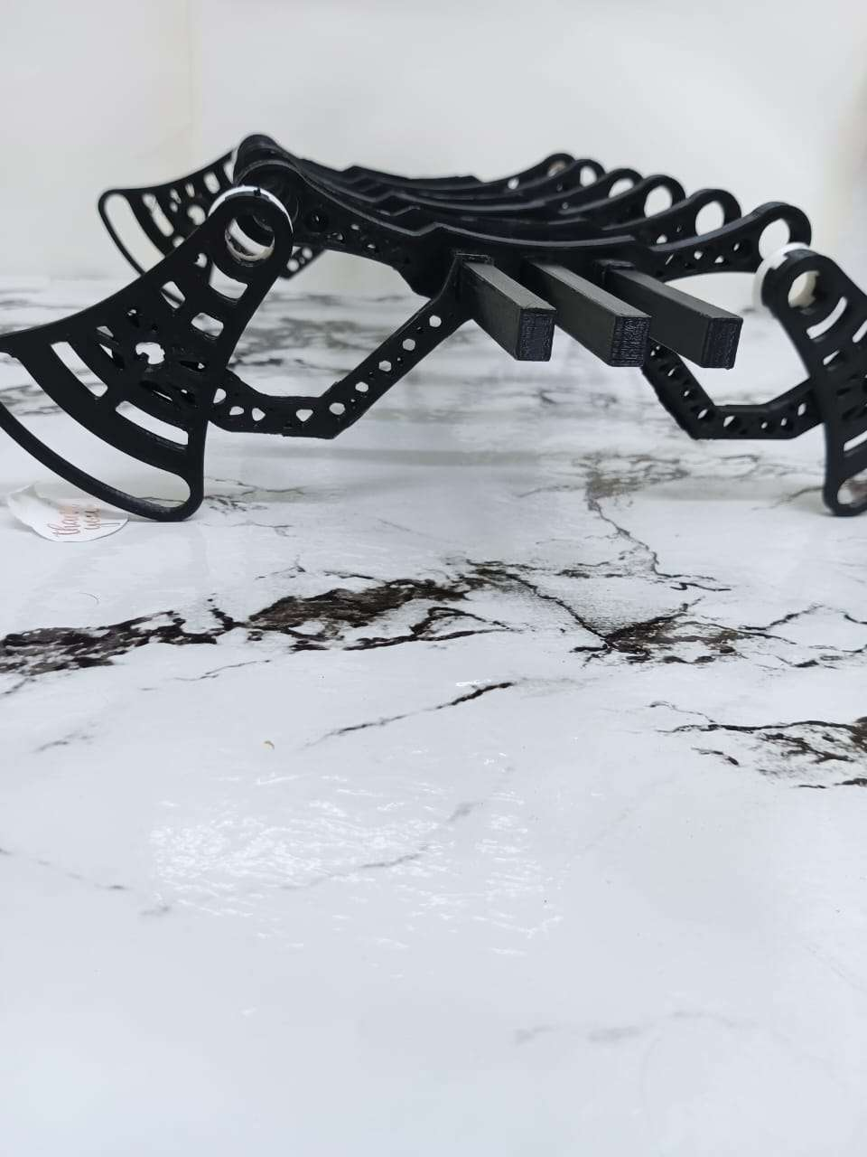
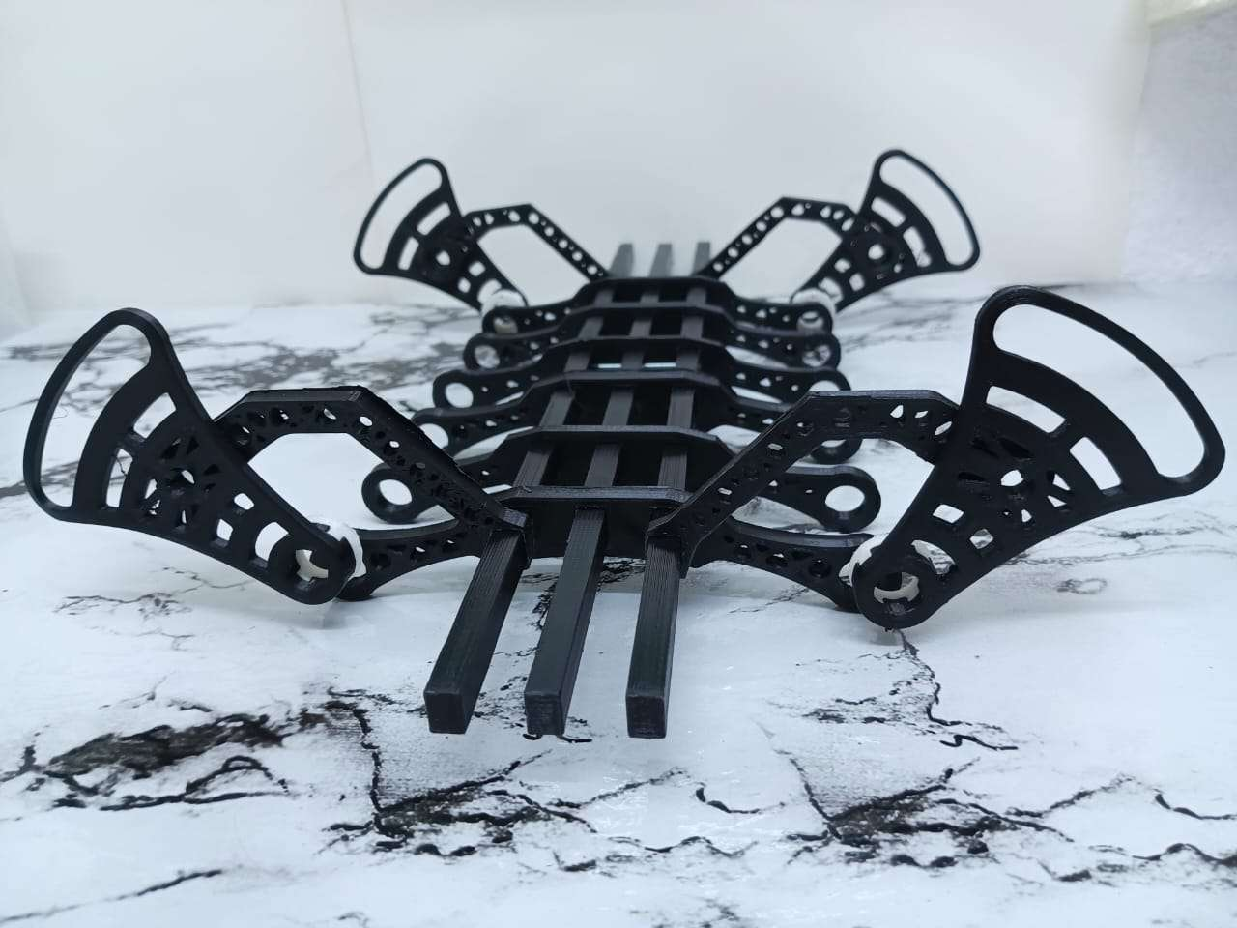
Design
Our Design
One of the most important characteristics of mine detector robots is the design because it deals with many environments with different terrain and obstacles.

Slide 22
Our Design
06
We took into consideration this characteristic of mine detector’s , so we used Parallel Link Suspension (Coil Spring Suspension , Double Wishbone Suspension).
to obtain high flexibility, balance, and the ability to act in whatever working environment conditions.
Code

Slide 23
06
Code

Slide 24
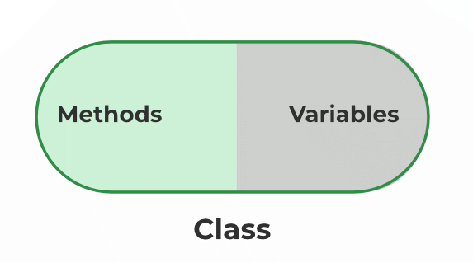
Code
encapsulation
Object-oriented design revolves around the concept of objects, which encapsulate data and behavior into a single entity. It promotes modular development, code reusability, and easier maintenance. The three fundamental principles of object-oriented programming (OOP) are encapsulation, inheritance, and polymorphism.

Slide 25
encapsulation
Encapsulation in C++ is defined as the wrapping up of data and information in a single unit. In Object Oriented Programming, Encapsulation is defined as binding together the data and the functions that manipulate them.
OOP

Slide 26
references
in our code we use encapsulation principle from principles
OOP

Slide 27
references
https://clearpathrobotics.com/coimbra-autonomous-demining-husky/
https://www.youtube.com/watch?v=xju4rgRL4j0&ab_channel=ClearpathRoboticsbyRockwellAutomation
https://spectrum.ieee.org/husky-robot-takes-on-landmine-detection-while-humans-stay-very-very-far-away
https://www.instructables.com/How-to-Interface-PS2-Wireless-Controller-W-Arduino/
https://chatgpt.com/c/7838c886-a2e8-4bd0-ba0d-86140997d992
Introduction to Autonomous Mobile Robots, Second Edition
By Roland Siegwart, Illah Reza Nourbakhsh and Davide Scaramuzza
https://nexwebsites.com/blog/object-oriented-design-with-cpp/
https://www.geeksforgeeks.org/encapsulation-in-cpp/
If you have any questions, please keep it for yourself I’m not Google

Slide 28

If you have any questions, please keep it for yourself I’m not Google

